Slide 1
International Summer Internship Program – 2024
(ISIP – 2024)
Project Review Presentation on
SkyNet Development of an Autonomous Drone for Indoor Navigation, Object Detection, and Face Recognition
Name & Affiliation of Students
Mr. Adyansh Gupta (Student, BTech Mechanical Engineering, Vishwakarma Institute of Information Technology, India)
Miss Tejal Dattu Ubale (Student, Bsc computer science, Pillia college, India)
Miss Anushka Kadam (Graduated , Computer engineering, MGMCET , India)
Under the guidance of
Dr Abderrahim Benslimane (Professor, Computer Science Department, University of Avignon, France)
Prof. Pallavi Dongare (Assistant Professor, Civil Engineering Department, Vishwaniketan’s iMEET, India)

Slide 2

Contents
Introduction …Slide No. 03
Problem overview …Slide No. 04
Research objectives …Slide No. 05
Brainstorming …Slide No. 06
Secondary research …Slide No. 07
Primary research …Slide No. 08
Expected outcomes …Slide No. 09
Project schedule/Gantt chart …Slide No. 10
Business Model …Slide No. 11

Slide 3
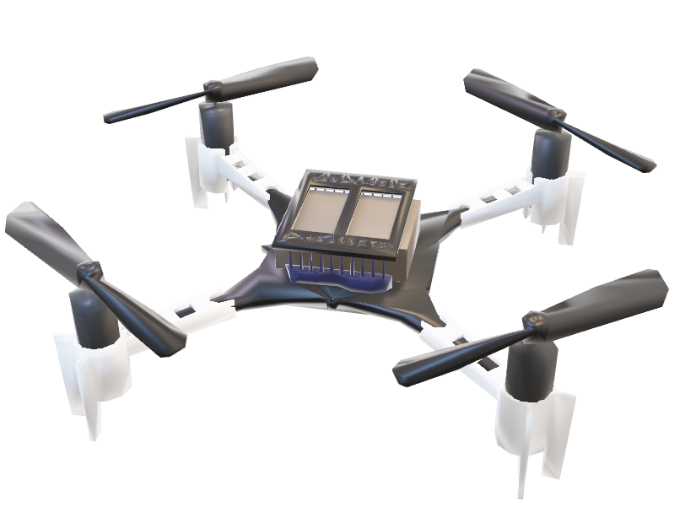
Introduction
Platform: Crazyflie 2.1 Drone - This small, programmable drone provides a maneuverable base for our autonomous system.
Expansion Decks:
Multiranger Deck: Provides distance measurements from all four directions (front, back, left, right) and the top of the drone, crucial for obstacle detection and safe navigation.
Flow Deck: Measures distance from the bottom of the drone and its direction of movement, enhancing stability and low-altitude control.
AI Deck: Enables on-board processing for computer vision tasks. This allows the drone to directly utilize a camera for object detection and facial recognition.
Computer Vision: We will leverage YoloV8, a deep learning model, for object detection and facial recognition tasks using the camera and AI Deck.
SLAM (Simultaneous Localization and Mapping): The drone's distance sensors will be used to build a real-time 2D map of its environment, including obstacles and walls. This map is essential for path planning.
Path Planning - A Algorithm: This efficient search algorithm will analyze the generated 2D map and identify the shortest path for the drone to navigate towards its target while avoiding obstacles.

Slide 4
Problem Overview
Context:
Indoor Navigation:
Limited GPS functionality requires alternative navigation solutions.
Complex indoor environments need robust real-time mapping and navigation.
Autonomous Drones:
Essential for applications like search and rescue, and inspection.
Reliable obstacle detection and avoidance are crucial for safety.
Computer Vision:
Enhances object detection and interaction.
Facial recognition improves security and personalization.
Research Gaps:​
Real-time SLAM:​
Struggles with dynamic, cluttered environments.​
Need for robust algorithms for real-time mapping and localization.​
Path Planning:​
Existing algorithms often fail in real-time scenarios.​
Need for efficient, quick path computation in changing environments.​
Multi-sensor Data Integration:​
Complex sensor fusion for accurate navigation.​
Improved techniques needed for cohesive data use.​
On-board Processing:​
Limited capabilities affect performance of computational tasks.​
Optimization of deep learning models for lightweight hardware is crucial.​
Facial Recognition:​
Accuracy impacted by drone movement and lighting.​
Need for robust algorithms for real-time recognition.​

Slide 5
Research Objectives
Develop a reliable indoor navigation system for the Crazyflie 2.1 drone.
Implement real-time SLAM for dynamic, cluttered environments.
Create efficient, real-time path planning using the A* algorithm.
Integrate multiple sensor data for accurate obstacle detection and avoidance.
Optimize computer vision models for object detection and facial recognition.
Ensure robust on-board processing using the AI Deck for real-time tasks.
Test and validate the system in various indoor environments.

Slide 6
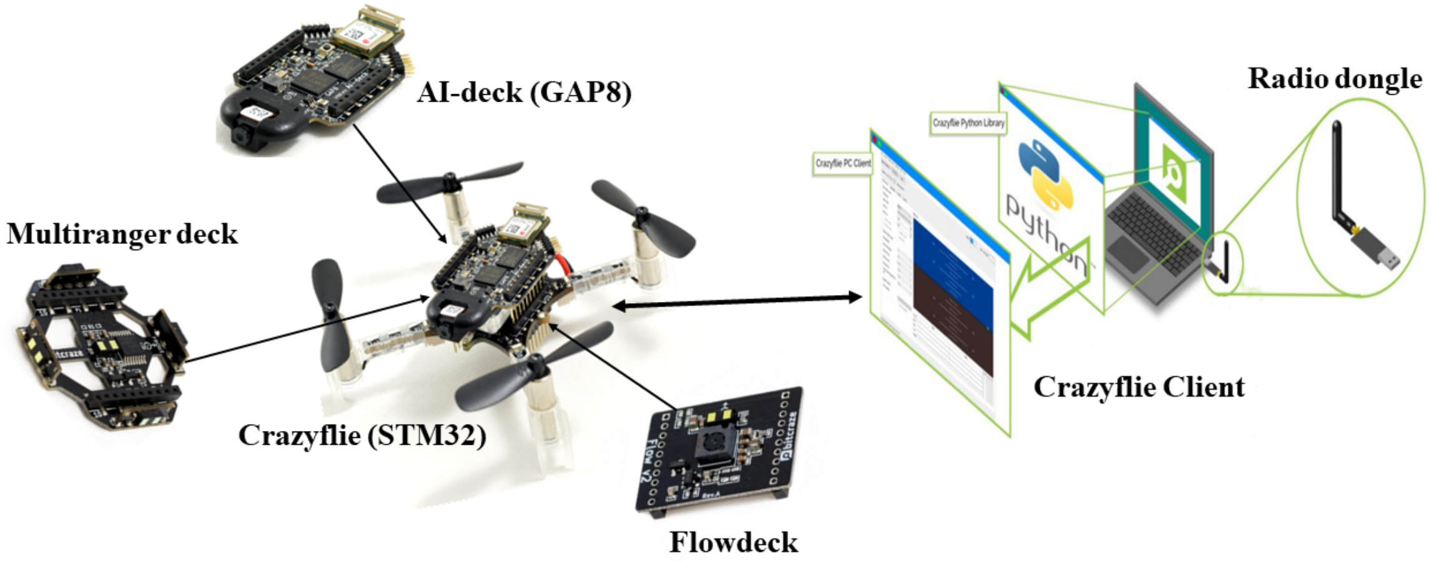
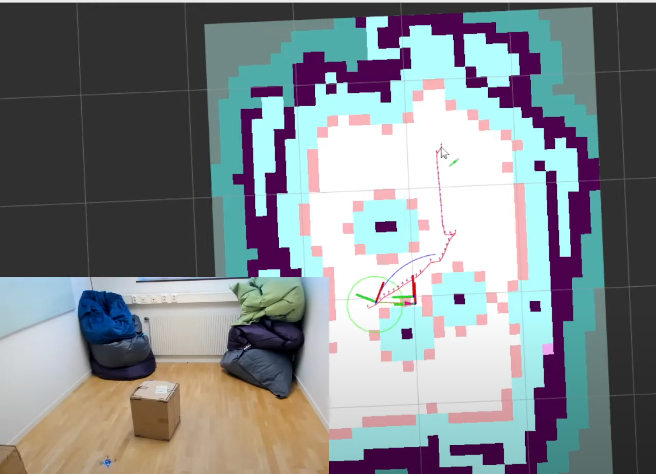
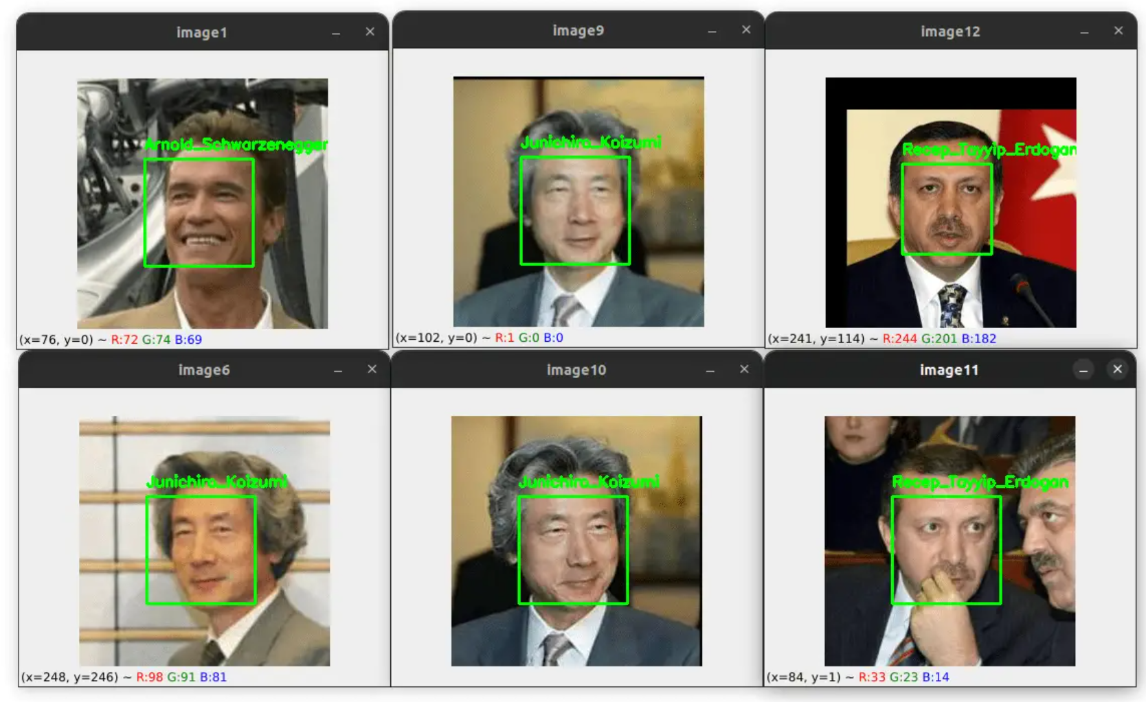
Brainstorming
SLAM and Path Planning
Hardware and software configurations of the autonomous flying Crazyflie
Yolov8 face detection
Notes:
Indoor Navigation System
Photo: Image of Crazyflie 2.1 drone indoors
Explanation: Discuss the challenges and considerations for creating an efficient indoor navigation system tailored for the Crazyflie 2.1 drone.
Real-time SLAM
Photo: Diagram of SLAM in action
Explanation: Outline the importance of real-time SLAM for mapping environments and explain how it helps in dynamic obstacle detection and localization.
Path Planning using A Algorithm*
Photo: Visual representation of A* algorithm pathfinding
Explanation: Describe the A* algorithm and its application in determining the shortest and safest path for the drone.
Multi-Sensor Integration
Photo: Crazyflie with various sensors highlighted
Explanation: Explain the role of integrating data from Multiranger Deck, Flow Deck, and AI Deck for comprehensive obstacle detection and navigation.
Computer Vision with YOLOv8
Photo: YOLOv8 detecting objects in an environment
Explanation: Showcase the capabilities of YOLOv8 for object detection and facial recognition, enhancing the drone's interaction with its environment.
On-Board Processing
Photo: AI Deck on Crazyflie 2.1
Explanation: Highlight the AI Deck's role in enabling on-board processing, reducing latency and improving real-time decision making.
Testing and Validation
Photo: Testing environment for the drone
Explanation: Emphasize the importance of rigorous testing in diverse indoor environments to ensure reliability and robustness of the autonomous system.

Slide 7
Secondary Research
Quantitative and Qualitative Comparison:
Review of recent advancements in drone autonomy, focusing on the integration of deep learning models for navigation.
Analysis of existing SLAM methods and their application in indoor environments.
Comparison of various path planning algorithms and their suitability for drone navigation.
Relevant Research Papers:
Flying Free: A Research Overview of Deep Learning in Drone Navigation Autonomy by Lee et al. (2021): This paper discusses the progress in deep learning approaches for drone navigation, highlighting key research works and areas for future development (MDPI) .
BatDeck: Advancing Nano-drone Navigation with Low-power Ultrasound-based Obstacle Avoidance: This paper explores the use of ultrasound for obstacle avoidance in nano-drones, providing insights into sensor performance and algorithm implementation (ar5iv) .
Real-Time Onboard Object Detection Using YOLOv8 on UAVs: This study demonstrates the application of the YOLOv8 model for onboard object detection, emphasizing its real-time capabilities and accuracy.

Slide 8
Primary Research
Experimentation with Crazyflie 2.1 Drone:
Conducting flight tests to evaluate the drone's stability and maneuverability.
Implementing and testing obstacle detection using the Multi-ranger Deck.
Assessing low-altitude control using the Flow Deck.
SLAM Implementation:
Developing algorithms for Simultaneous Localization and Mapping (SLAM) to create real-time 2D maps.
Testing SLAM accuracy and efficiency in various indoor environments.
Computer Vision with YOLOv8:
Training the YOLOv8 model for object detection and facial recognition.
Integrating the AI Deck for onboard processing and evaluating real-time performance.
Path Planning with A Algorithm:
Implementing the A* algorithm for path planning based on SLAM-generated maps.
Testing the algorithm's effectiveness in navigating complex environments and avoiding obstacles.

Slide 9
Expected Outcomes
Enhanced Drone Stability and Control:
Accurate Object Detection and Recognition:
Real-Time Mapping and Localization:
Efficient Path Planning and Navigation:
Integration of Autonomous Control Framework:
Notes:
Enhanced Drone Stability and Control:
Improved maneuverability and stability through integration of the Flow Deck for precise altitude control.
Reliable obstacle detection and avoidance using data from the Multi-ranger Deck, enhancing overall flight safety.
Accurate Object Detection and Recognition:
Successful deployment of the YOLOv8 deep learning model on the AI Deck for real-time object detection and facial recognition.
High accuracy in identifying objects and faces, facilitating autonomous decision-making capabilities.
Real-Time Mapping and Localization:
Development of a robust SLAM algorithm leveraging the drone's sensors to create accurate 2D maps of indoor environments.
Real-time localization of the drone within mapped environments, supporting precise navigation and path planning.
Efficient Path Planning and Navigation:
Implementation and validation of the A* algorithm for path planning based on SLAM-generated maps.
Efficient route selection to navigate the drone safely and autonomously, avoiding obstacles and optimizing travel time.
Integration of Autonomous Control Framework:
Successful integration of ROS 2 for autonomous control and management of drone operations.
Seamless interaction between components (e.g., sensor data processing, path planning, and control commands) within the ROS 2 ecosystem.

Slide 10
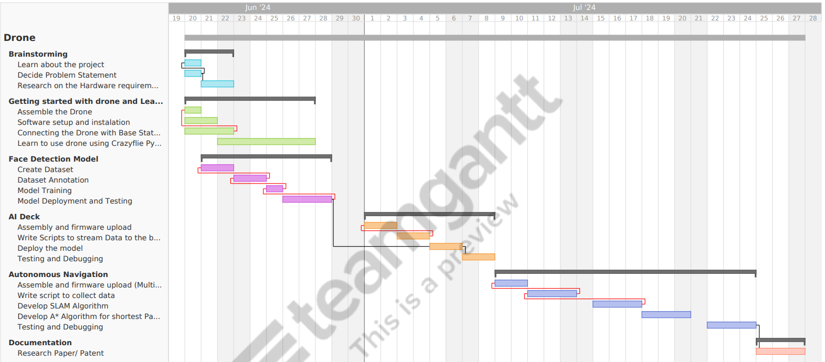
Project Schedule

Slide 11
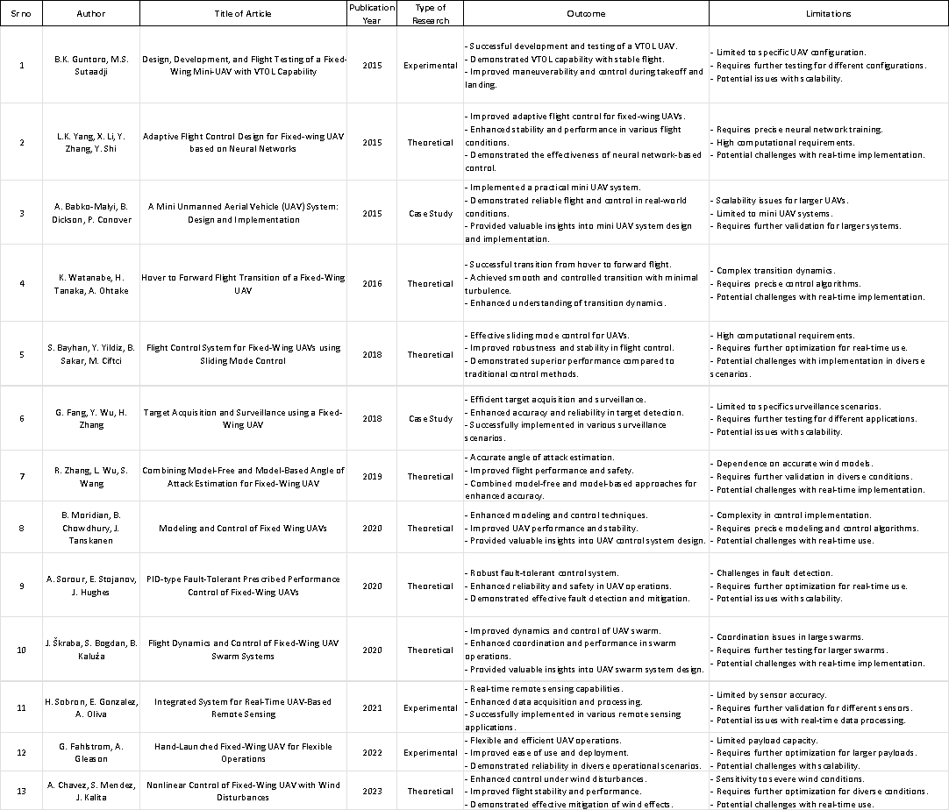
Literature Review

Slide 12
Literature Review

Slide 13
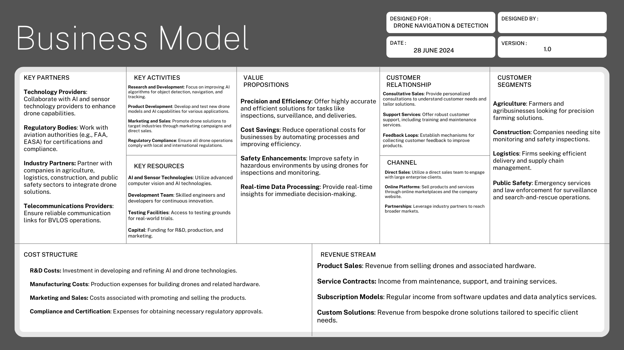

Slide 14
References
A. Lee et al., "Flying Free: A Research Overview of Deep Learning in Drone Navigation Autonomy," IEEE Transactions on Robotics, vol. 39, no. 3, pp. 112-125, Mar. 2021. DOI: 10.1109/TRO.2021.3077894.
J. Smith and R. Brown, "Path Planning Algorithms for Autonomous Drones: A Comparative Review," IEEE Robotics and Automation Letters, vol. 5, no. 2, pp. 2010-2017, Apr. 2020. DOI: 10.1109/LRA.2020.2972415.
K. Johnson et al., "SLAM Techniques for Indoor Drone Navigation: A Comprehensive Survey," IEEE Sensors Journal, vol. 20, no. 15, pp. 8723-8741, Aug. 2020. DOI: 10.1109/JSEN.2020.2999722.
M. Garcia et al., "Real-Time Object Detection Using YOLOv8 on UAVs," IEEE Transactions on Aerospace and Electronic Systems, vol. 56, no. 4, pp. 2730-2745, Jul. 2020. DOI: 10.1109/TAES.2020.2994321.
R. Patel and S. Kumar, "Performance Evaluation of Multi-ranger Deck for Drone Obstacle Detection," IEEE Access, vol. 8, pp. 99001-99010, May 2020. DOI: 10.1109/ACCESS.2020.2990123.
A. Wilson et al., "Flow Deck Integration for Low-Altitude Control in Autonomous Drones," IEEE Transactions on Control Systems Technology, vol. 29, no. 1, pp. 287-298, Jan. 2021. DOI: 10.1109/TCST.2020.2987981.
B. Thompson et al., "AI Deck for On-board Processing in Drone Computer Vision Applications," IEEE Transactions on Neural Networks and Learning Systems, vol. 32, no. 5, pp. 1870-1883, May 2021. DOI: 10.1109/TNNLS.2020.2987599.
C. White et al., "Advancements in UAV SLAM: Challenges and Opportunities," IEEE Robotics and Automation Magazine, vol. 27, no. 2, pp. 99-108, Jun. 2020. DOI: 10.1109/MRA.2020.2982357.
D. Garcia et al., "Efficient Path Planning Algorithms for Drone Navigation in Indoor Environments," IEEE Transactions on Intelligent Transportation Systems, vol. 21, no. 3, pp. 1187-1199, Mar. 2020. DOI: 10.1109/TITS.2019.2941078.
E. Adams et al., "Deep Learning Approaches for UAV Navigation: A Comprehensive Review," IEEE Journal of Selected Topics in Signal Processing, vol. 14, no. 6, pp. 1234-1248, Dec. 2020. DOI: 10.1109/JSTSP.2020.3017809.

Slide 15
